Slide 1
Experimental approach
By LAURENT Lou & CASCA Thomas

Slide 2
TABLE OF CONTENTS
01
02
Introduction
ATMEL introduction
03
04
Motor control
Collision detector
Fast introduction of the main goal of this project
Introduce the differents functions and registers
To show how we used the Joystick, H-bridge, Sense detection and modelization
Description of Map processing by using servo motor and ultrasond sensor
1
Notes:
1.Introduction
2.Atmel Introduction
Timer
PWM
Pin Interruption
3.Motor control
Joystick
H-bridge
Sense détection
PID
4.Collision detector
ultrasound sensor
servo motor
5.Conclusion

Slide 3

Introduction
CHALLENGE
SOLUTION
Goals
Build a Robot by using a ATMEL 328P Processor
Design circuits and program with integred processor functions
Understand how to control motor with modelisation and low level programming
2

Slide 4
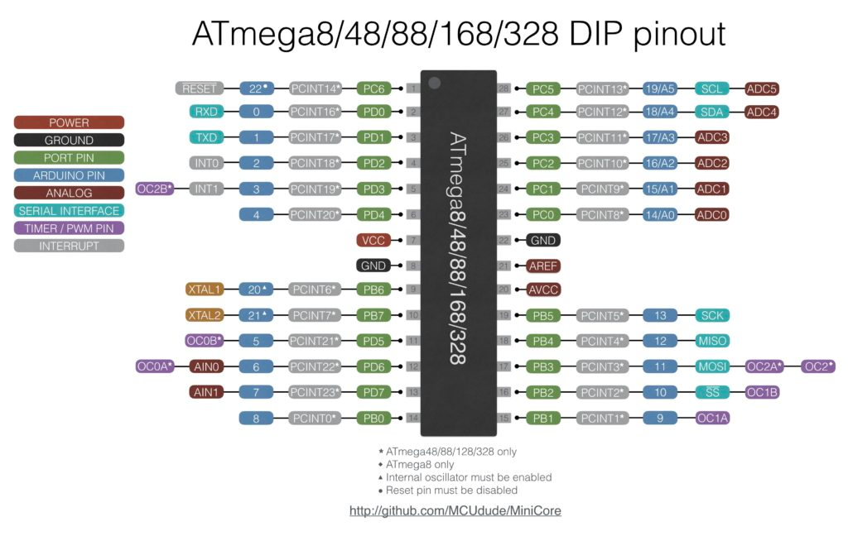
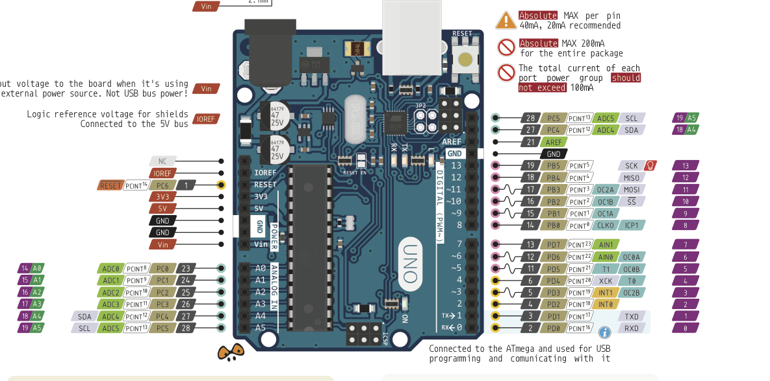
ATMEL Introduction
3

Slide 5

Atmel Fonction
Timers
PIN interruptions
PWM
Register used :
Register used :
Register used :
TCCRxA
TCCRxB
TCNTx
TIMSKx
PCICR
PCMSKn
TCCRxA
TCCRxB
TCNTx
OCRxn
Fonction used :
Fonction used :
ISR(TIMERx_OVF_vect)
ISR(PCINTn_vect)
4

Slide 6


Motor Control
DC Motor
Joystick
H-bridges
5

Slide 7
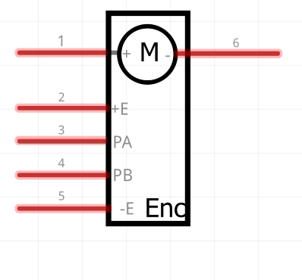
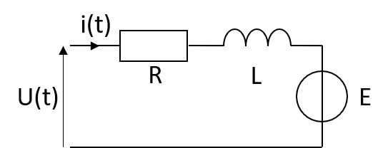
DC Motor
6

Slide 8
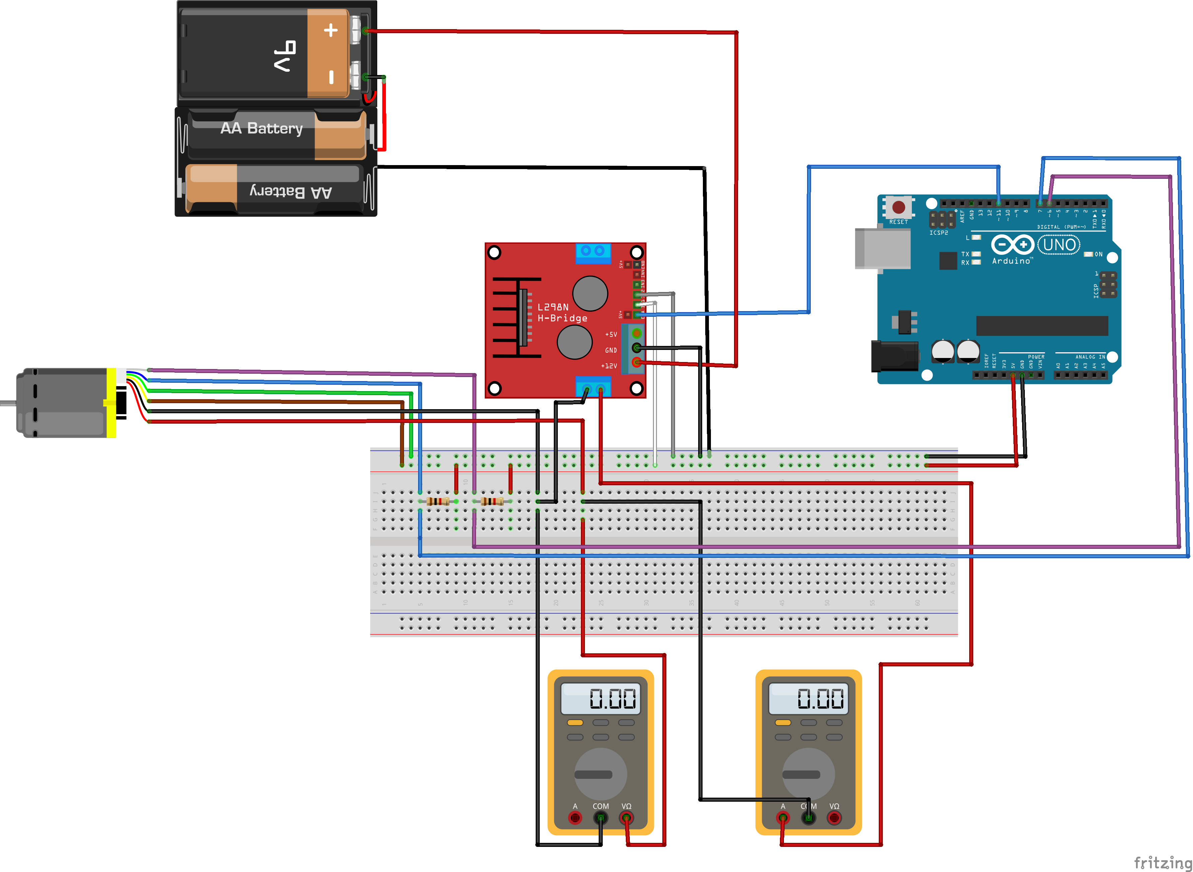
Identification of motor variables
7

Slide 9

Identification of motor variables
$$\left\{\begin{aligned}U=E+Ri+L\frac{di}{dt} \\ J\frac{dΩ}{dt}=Γ_{m}−Γ_{r}−fΩ \\ E=kΩ \\ Γ_{m}=ki \end{aligned}\right.$$
8

Slide 10








Deduction the motor’s resistance
$$+ L\frac{di}{dt}$$
$$U=Ri$$
$$+ E$$
$$R=5,1 Ω$$
$$⇔\frac{di}{dt}=0$$
$Ω$constant, $U=12V$ $⇔$ $i$ constant
Wheel lock$⇔Ω=0$
$$⇒E=kΩ=0$$
9

Slide 11


Deduction of motor’s constant
$E=kΩ$
$$⇒k_{moy}=0,209 J.A^{−1}$$
10

Slide 12






Deduction of motor’s friction
$$J\frac{dΩ}{dt}=Γ_{m}−Γ_{r}−fΩ$$
$⇒Ω$constant
$$Γ_{m}=f\left(Ω\right)= Γ_{r}+fΩ$$
$$Γ_{m}=ki$$
$$Γ_{r}=0.0206 J$$
$f=6.79∗{10}^{−5} J.s$
11

Slide 13
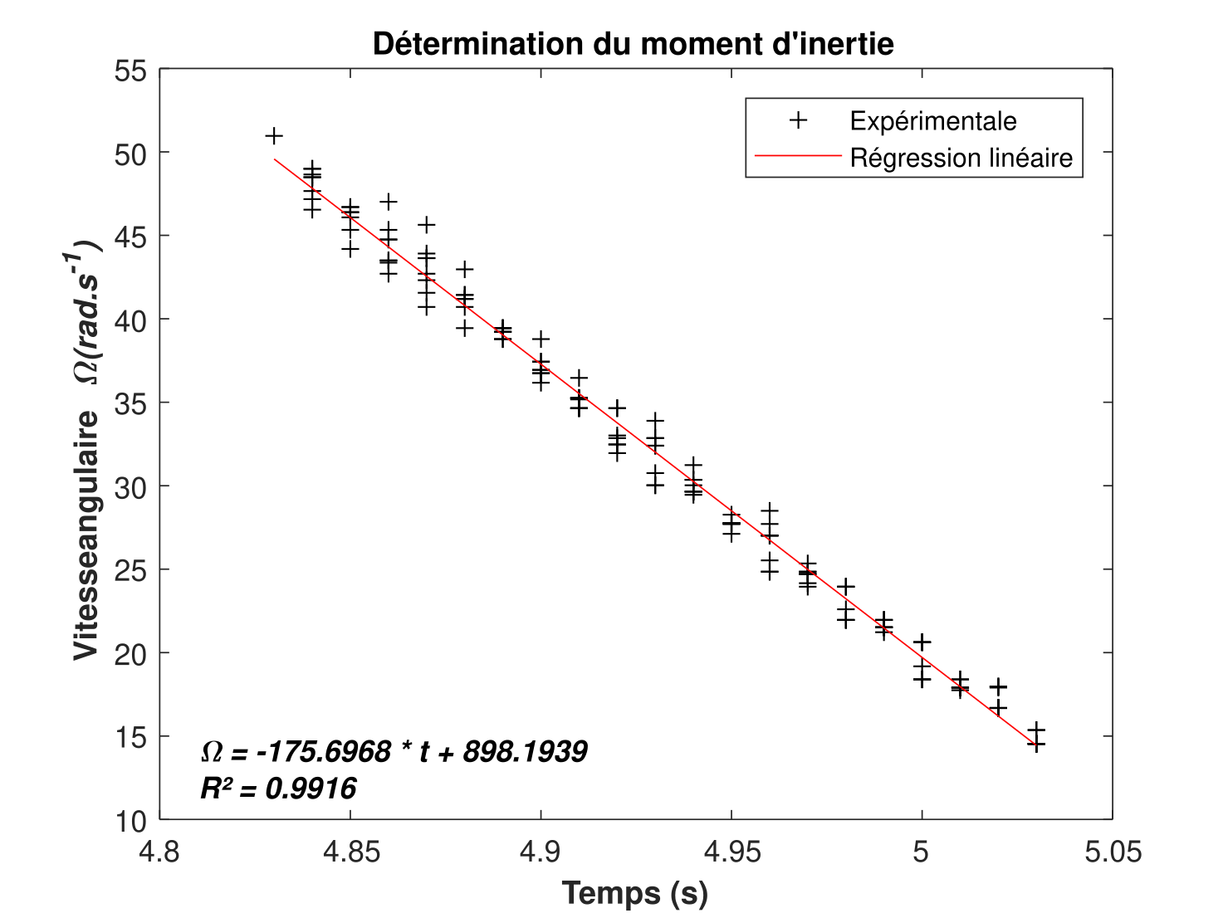


Deduction of inertia moment
$$J\frac{dΩ}{dt}=Γ_{m}−Γ_{r}−fΩ$$
$$J=\frac{Γ_{m}−Γ_{r}−fΩ}{\frac{dΩ}{dt}}=1.37∗{10}^{−4} kg.m²$$
12

Slide 14
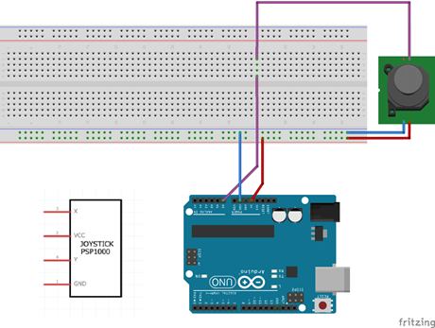
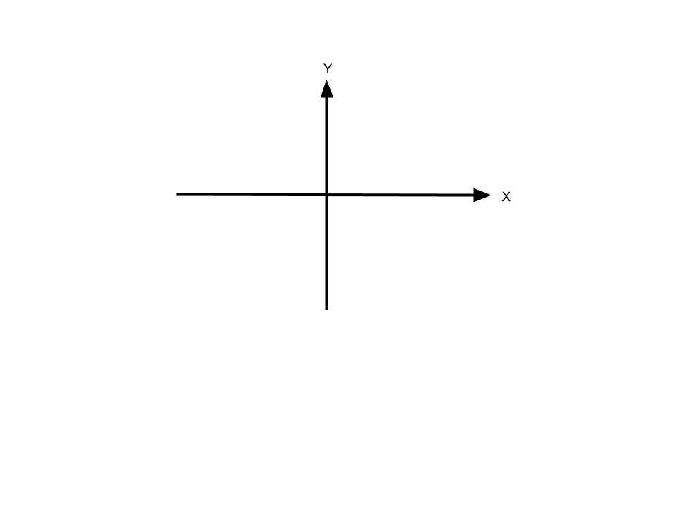
Joystick
13

Slide 15
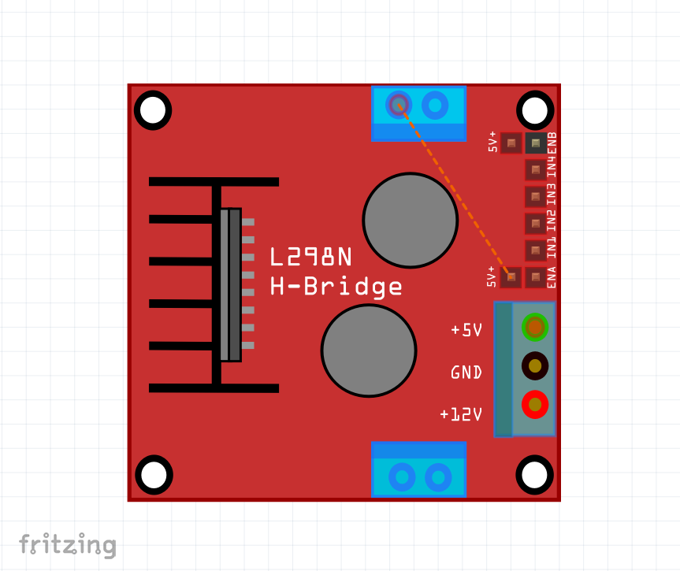
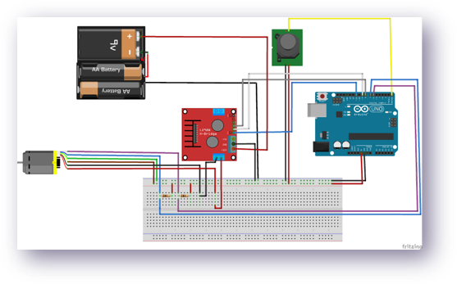
H-bridges
14

Slide 16
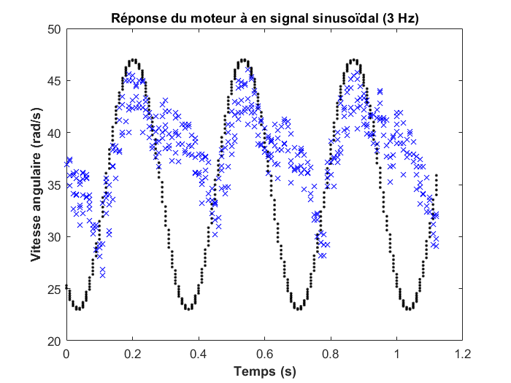
Filter
15

Slide 17
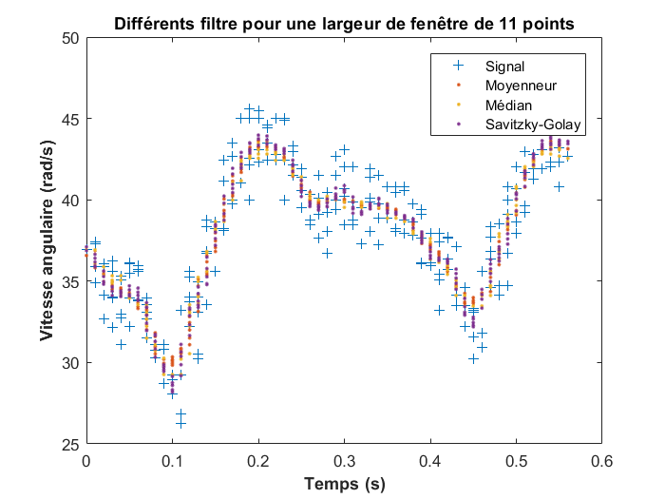
Filter
16

Slide 18
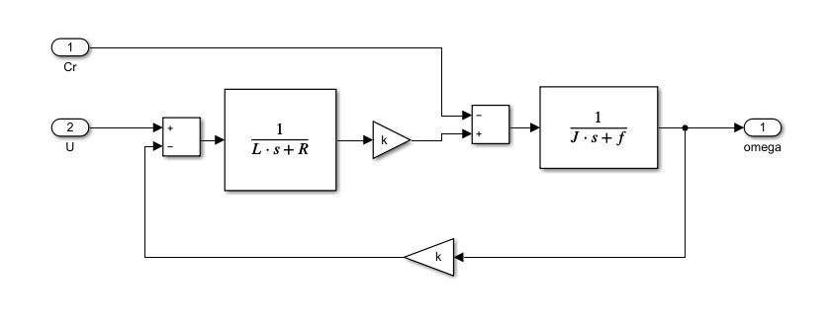
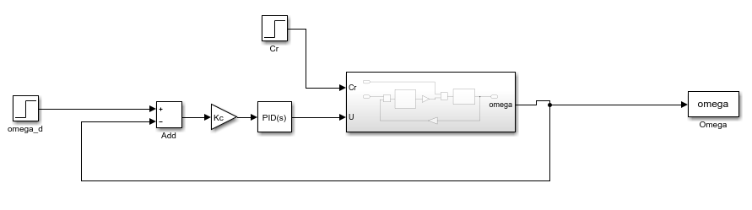
PID
17

Slide 19

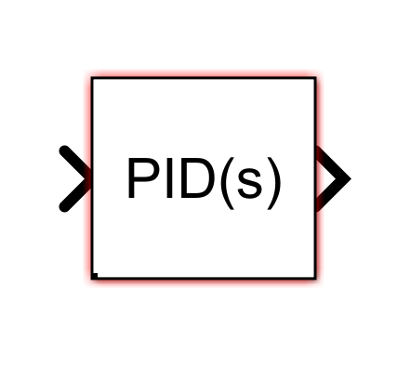
PID Simulation
18

Slide 20
PID Simulation
19

Slide 21

PID Simulation
$$Corrector\left(p\right)=Kp$$
20

Slide 22

PID Simulation
$$Corrector\left(p\right)=Kp(1+Ki.\frac{1}{p})$$
21

Slide 23

PID Simulation
$$Corrector\left(p\right)=$$
22

Slide 24
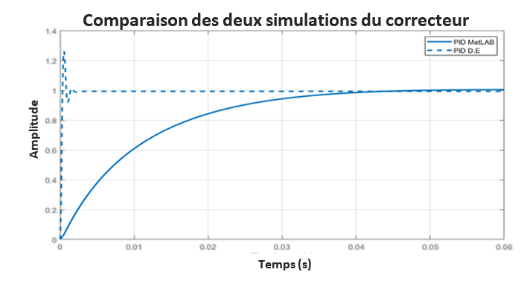
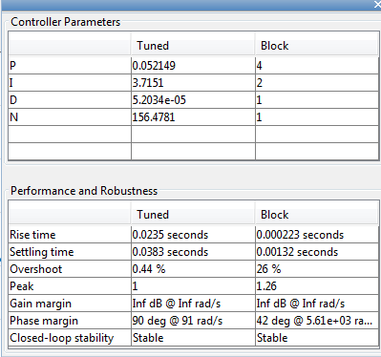
PID Simulation
23

Slide 25
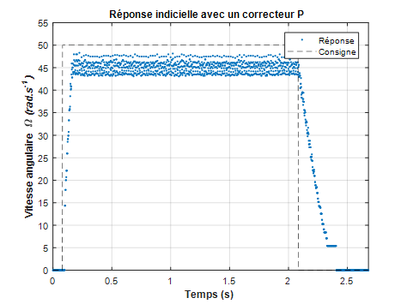
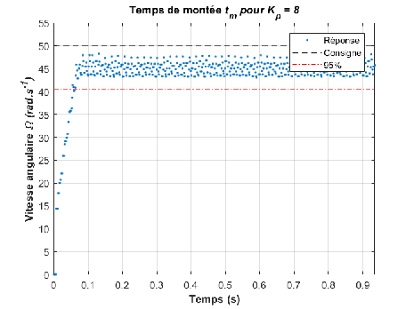
Experimental PID
24

Slide 26
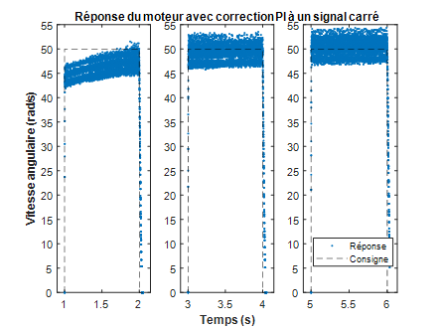
Experimental PID
25

Slide 27
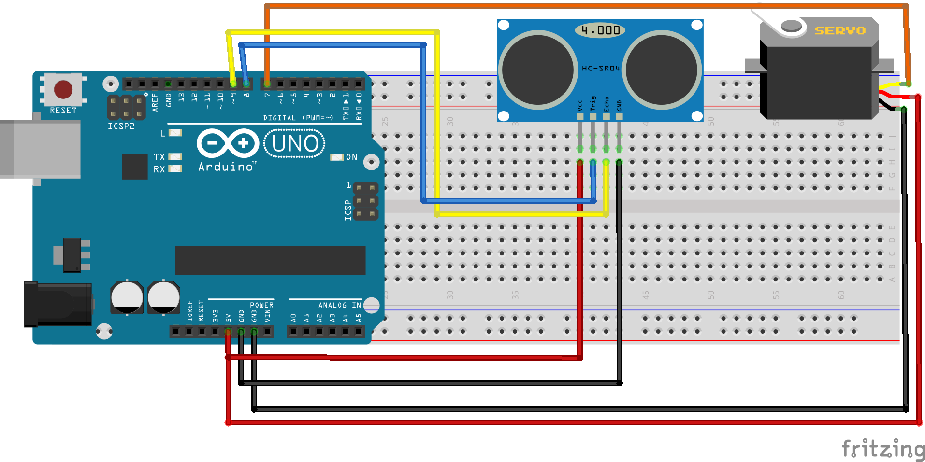
Collision detector
26

Slide 28
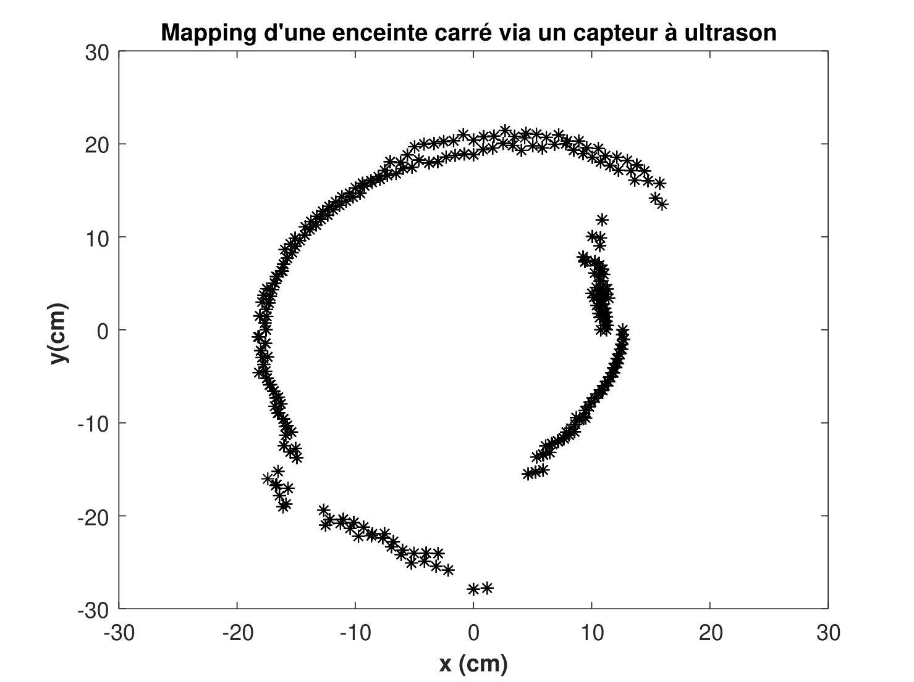
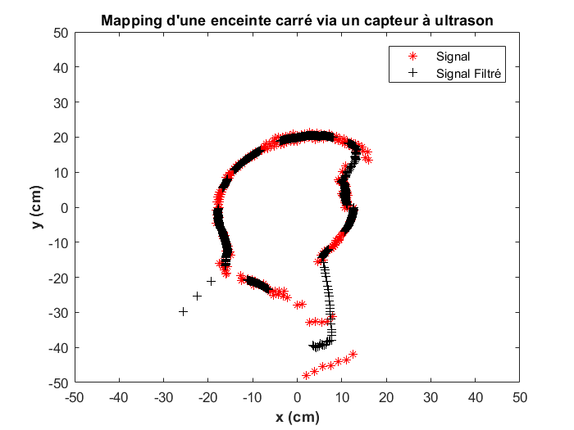
Collision detector
27

Slide 29
THANKS

Slide 30


Slide 35
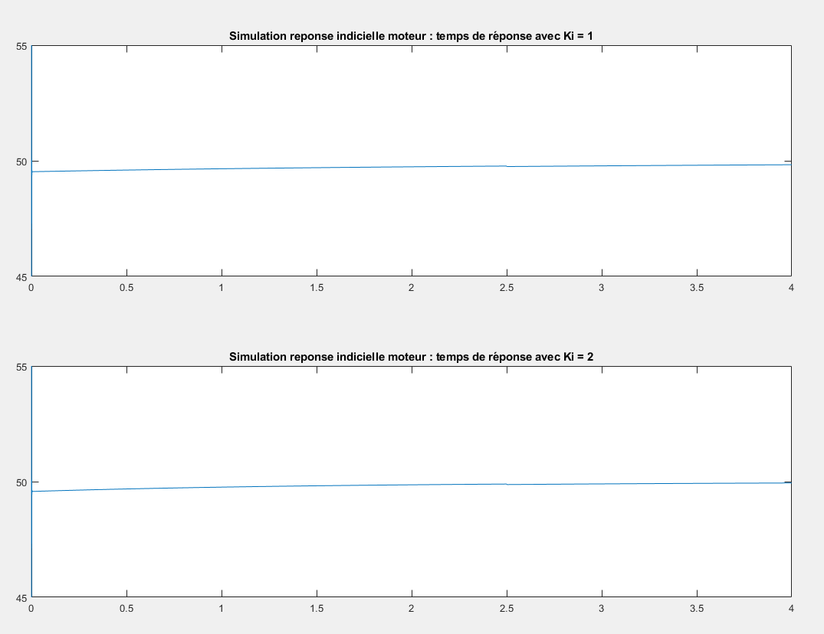

Slide 37
